Slide 1
Encoding sketches into a numerical representation

Slide 2
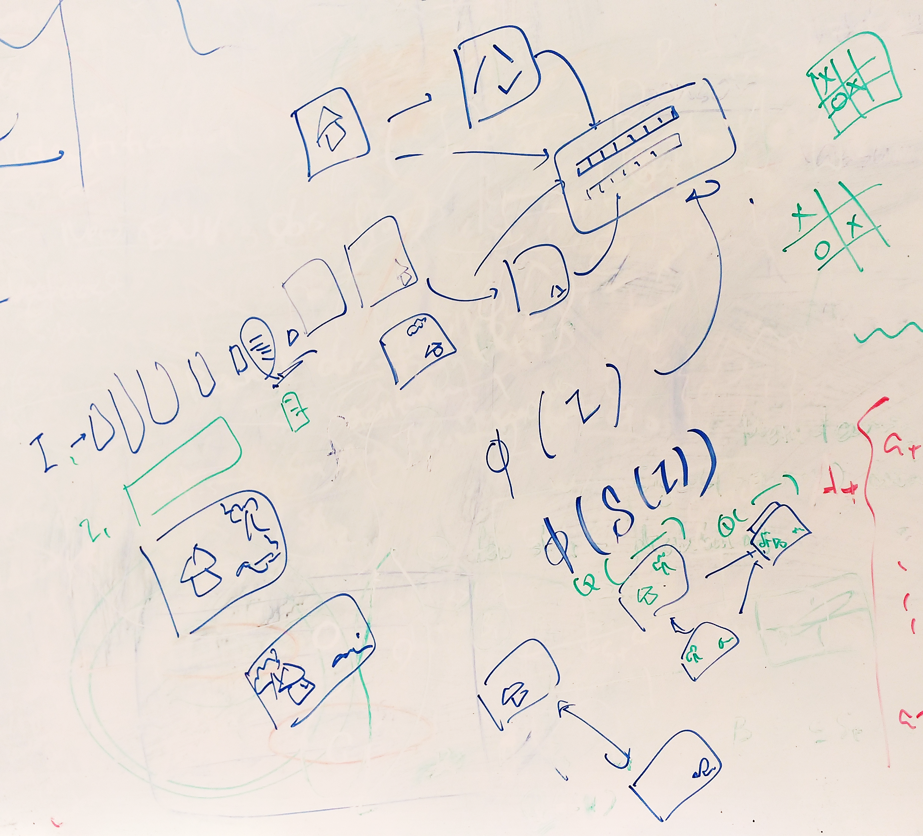
Last week discussion

Slide 3
Two approaches
1. Image mapping without Segmentation
2. Image mapping with Segmentation information

Slide 4
First Approach Image mapping without Segmentation

Slide 5
Experimenting with Autoencoder
I experimented with both the simple network and CNN to see if we can have a good numerical representation

Slide 6

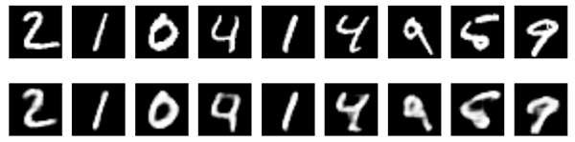
Experimenting with Autoencoder
Both the simple encoder and CNN have worked well with MNIST dataset

Slide 7
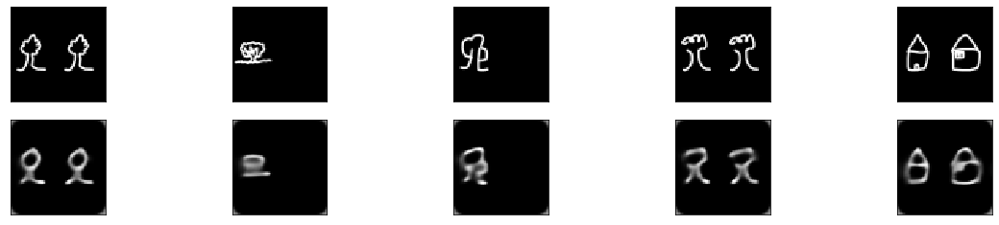
Experimenting with Autoencoder
We got good representation of image for the purpose of reconstruction. The ones above are the original image. The ones below are reconstructed images.

Slide 8
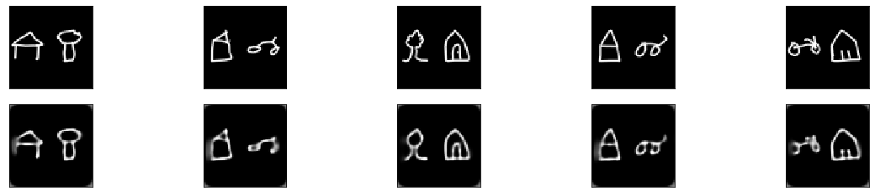
Experimenting with Autoencoder

Slide 9
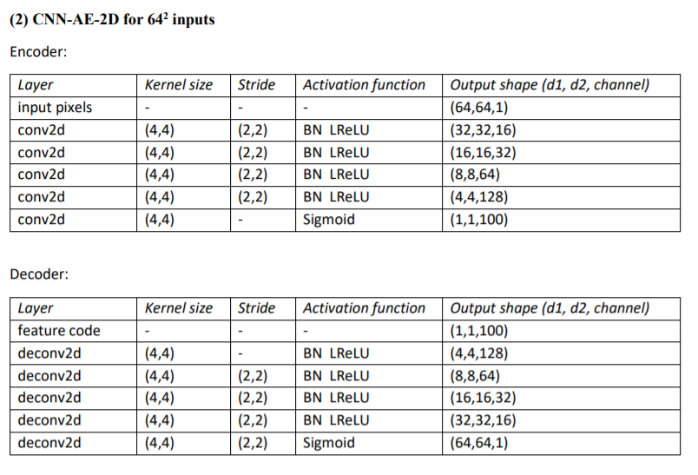

Slide 10
Experimenting with Autoencoder
However, this representation is only good for representation. We cannot infer a similarity measure from similar or totally different sketches based on Cosine distance.
Unless, we have another type of distance measure.
Distance measures are presented in next page:

Slide 11
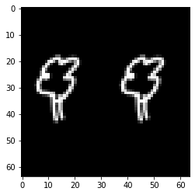
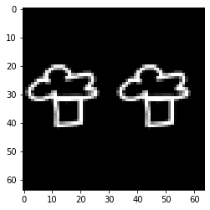
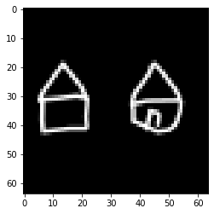
Distance measures
Ravel the image pixel and then get the cosine distance on 1-D array
0.4163639545440674
0.3442939519882202
Therefore, we cannot generate a similarity measure from the Autoencoded representation the one on the right have higher similarity.

Slide 12
Next direction: Siamese Network
Because the Autoencoder network fails to give us a similarity measure, we need a new architecture that give us and minimize distance when we have similar sketches. I found these three papers that I will try to investigate this week.

Slide 13
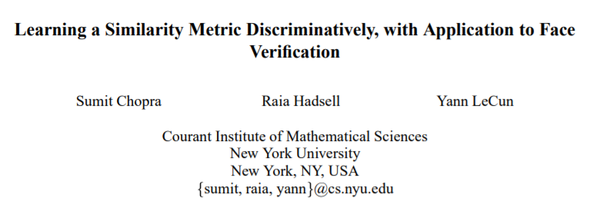
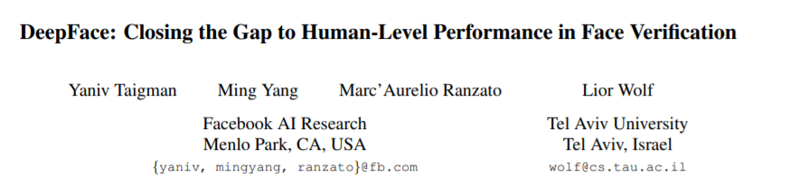
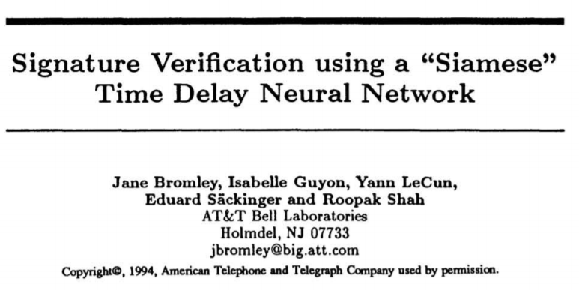
Siamese Network
http://papers.nips.cc/paper/769-signature-verification-using-a-siamese-time-delay-neural-network.pdf
https://www.cs.toronto.edu/~ranzato/publications/taigman_cvpr14.pdf
http://yann.lecun.com/exdb/publis/pdf/chopra-05.pdf

Slide 14
Siamese network
Siamese networks were first introduced by Bromley and LeCun [1] in early 1990s to solve signature verification as an image matching problem. A similar Siamese architecture was independently proposed for fingerprint identification by Baldi and Chauvin [2] in 1992. Later in 2015, Gregory Koch et al. [3] proposed to use Siamese neural networks for one-shot image recognition.

Slide 15
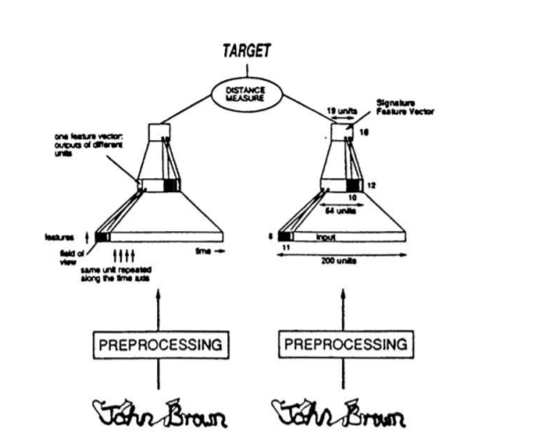
Siamese network

Slide 16
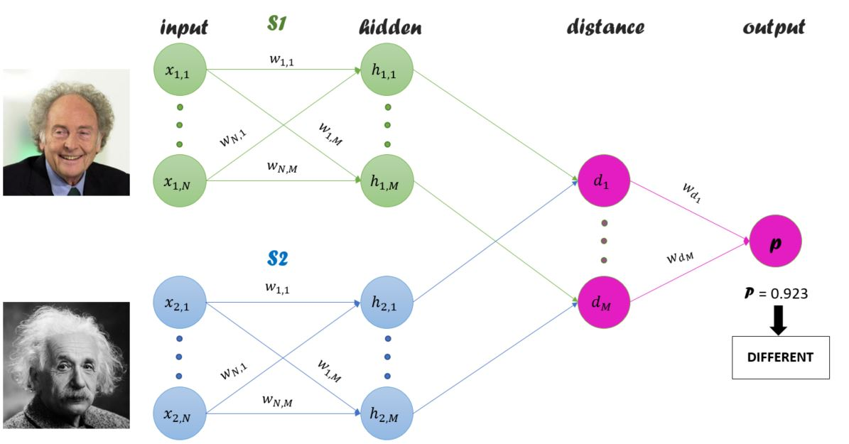
Siamese network

Slide 17
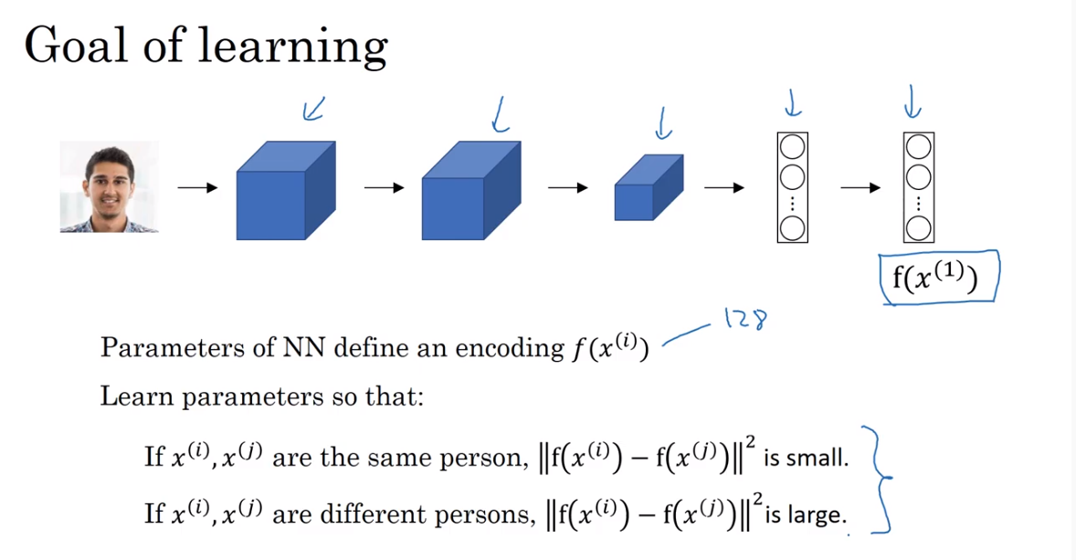
Siamese network

Slide 18
Second Approach Image mapping with Segmentation

Slide 19
Dataset available
We have the SketchyScene dataset with clearly labeled classes and segmentation. We can use these information to build a representation by itself or combined with the Siamese architecture above to answer this question:
Would the Siamese network work on the entire scene better or we get the segmentations and then feed to the network to find a similarity measure between segmentations?
Would a simple dictionary building approach of segmentations and objects can generate a similarity measure as well?
I will work on these questions next few weeks.

Slide 20
